Slide 1
Project Report
Topic: Banking Management System
OOPS ASSIGNMENT
Member’s:
Sujeet & Vikas

Slide 2
About: Bank Management System
Bank Management System is used to keep the record of the clients, employees in banks.
It’s an application to manage personal & business accounts.
The system provides the access to the customer to create an account, deposit/withdraw the cash from his account, also to view reports of all accounts presence.

Slide 3
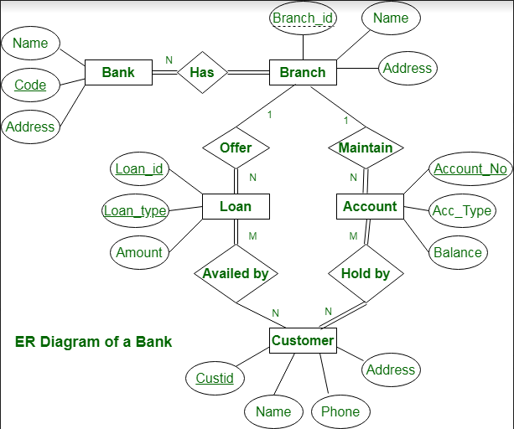
Banking Management System thus ensures smooth operation of the Real-Estate management tasks as well as keep the information about the employees and their salary.

Slide 4
Details of the project:
This Banking management system for Business Purpose
First there is intro of our group details
It’s Divided into two groups
First: Organisational manager login
Second: Employee Login
Member can login using ID and Password which is connected to MYSQL Database.

Slide 5
Details Cont...
Organisational manager login:
1) Employee Sign-Up
2) All employer list
3) Delete An account
Employee Login
1) Modify Account
2) Balance Enquiry
3) Deposit Amount
4) Withdraw Amount
5) Transactions

Slide 6
Challenges:
Connecting to database is the most important and interesting challenge of this project
Also there are some challenges like to maintain Interface, records and the manipulation to database because we have to connect to each query entry

Slide 7
Methodology:
First we made a Intro for the program
After that we gave the interface and after that we connect it to the database using mysql_real_connect.
And we modify database using stringstream which use to take input to the database query.
And we store the value of database while executing queries.

Slide 8
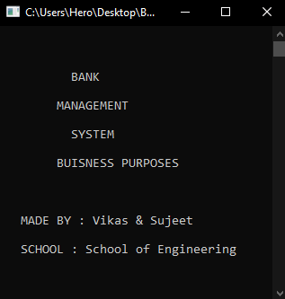
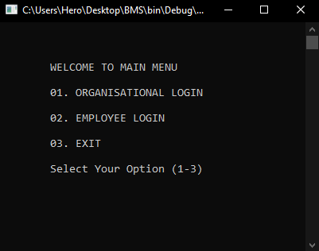
Interface Example’s
INTRO
MAIN MENU

Slide 9
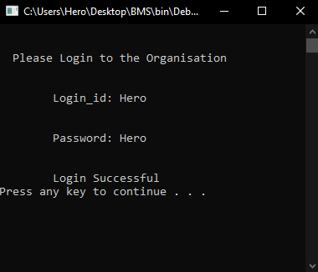
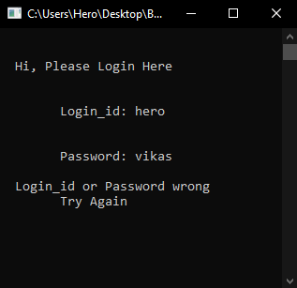
Interface Example’s
LOGIN Successful
LOGIN Error

Slide 10
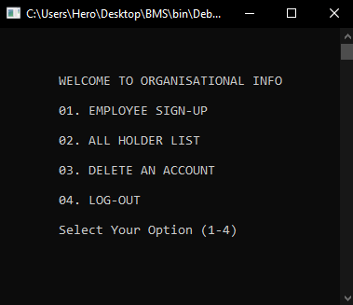
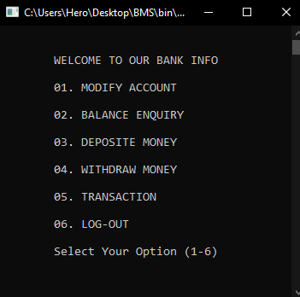
Interface Example’s
Organisational Login
Employee Login

Slide 11
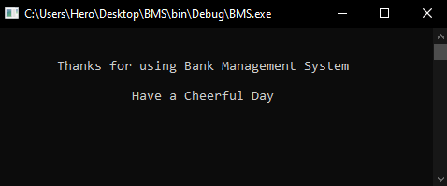
Interface Example’s
Outro

Slide 12


